Slide 1
Chapter 2 Logical algebra
2.1 Three Basic Functions of Logical Algebra
2.2 Laws and Rules of Logical Algebra
2.3 Function Transformation
2.4 Function Simplification

Slide 2
2.1 Three basic functions of
logical algebra
AND: logical multiplication
OR: logical addition
NOT: logical inverter

Slide 3
(1) “AND” function
switch
A
B
power
supply
F
E
light
Function Table
Truth Table
A B F
A B F
off off off
0 0 0
off on off
0 1 0
on off off
1 0 0
on on on
1 1 1

Slide 4
If all conditions are met, the event will occur.
It is named as logical multiplication (AND).
Logic function of “AND”
F＝f(A，B)=A·B＝AB
Logic gate of “AND” (hardware symbol)
A
F
B

Slide 5
(2) “OR” function
A
switch
power
supply
E
F
B
light
Function Table
Truth Table
A B F
A B F
off off
off
0 0 0
off on
on
0 1 1
on off
on
1 0 1
on on
on
1 1 1

Slide 6
If one condition is met, the event will occur.
It is named as logical addition (OR).
Logic function of “OR”
F＝f(A，B)＝A＋B
Logic gate of “OR” (hardware symbol)
A
F
B

Slide 7
(3) “NOT” function
R
resistor
E
power
supply
A
F
light
switch
Function Table
Truth Table
A F
A F
off on
0 1
on off
1 0

Slide 8
The input and output are inverting.
It is named as logical inverter (NOT).
Logic function of “NOT”
F＝A
Logic gate of “NOT” (hardware symbol)
A
F=A

Slide 9
2.2.1 Laws of logical algebra
2.2 Laws and Rules of Logical Algebra
(1) Laws of 0 and 1 (axioms)

Slide 10
(2) Laws of single variable (theorems)
(3) Commutative Law

Slide 11
(4) Associative Law
A(BC)=(AB)C=(AC)B
A+(B+C)=(A+B)+C=(A+C)+B
(5) Distributive Law
A(B+C)=AB+AC
distributive law of multiplication
distributive law of addition
A+BC=(A+B)·(A+C)
Proof: R.H.S. of Eq.=AA+AC+AB+BC=A+AC+AB+BC
=A(1+C+B)+BC=A+BC=L.H.S. of Eq.

Slide 12
(6) De Morgan’s Law
Proof by truth table:
0 0 0 1 1 1 1
0 1 0 1 1 0 1
1 0 0 1 0 1 1
1 1 1 0 0 0 0

Slide 13
Exercise
Prove the equation by truth table.

Slide 14
(7) The other commonly used laws
①
④
②
⑤
③
redundancy law
appending law
There are three product terms. The first two product terms contain the inverted variables A and A NOT. The third term contains the rest variables from the first two terms. The third term is redundant.

Slide 15
①
Proof:
②
Proof:
③
A+BC=(A+B)·(A+C) distributive law of addition
Proof:

Slide 16
④
A+BC=(A+B)·(A+C) distributive law of addition
Proof:

Slide 17
⑤
Proof:
L.H.S. of Eq.=
R.H.S. of Eq.
Extension of redundancy law ⑤:
Proof:
L.H.S. of Eq.
R.H.S. of Eq.

Slide 18
2.2.2 Rules of logical algebra
(1) Substitution Rule
Replace the variable with a function. Then the new expression is correct.
Example
Replace
Notes:
Replace B with DC.
Apply the De Morgan’s Laws.

Slide 19
De Morgan’s Laws
Replace B with more variables, and we get the general form of De Morgan's law:
Notes:
Replace B with more variables, we get the general from of De Morgan’s law.

Slide 20
(2) Inversion Rule
(we use it to write the inverse function.)
→
0 1
1 0
+
Exchange
+
Keep the operation order.
Notes:
The inverse function is written as F NOT.
Exchange 0 and 1. Exchange plus and dot.
Exchange original variable and inverted variable.

Slide 21
Write the inverse function.
Example 1
Example 2
Example 3
Notes:
Exchange original variable and inverted variable. Exchange plus and dot.
In example 1 and example 3, add parentheses to keep the operation order.
In example 2, the big inverter is offset.

Slide 22
(3) Duality Rule
(We use it to write the dual function.)
F(A，B，C )
F^{D}(A，B，C )
→
0
1
Exchange
1
0
+
+
A and are unchanged (keep the inverter).
Keep the operation order.
Notes:
The dual function is written as F-D

Slide 23
Properties of Duality Rule
(1) If an equation is correct, its dual form is also correct.
(2) If two functions are equal, their dual forms are also equal.
(3) If we apply the duality rule on a function twice, we will obtain the original function.
(F^{D})^{D} = F

Slide 24
Example: Use Duality Rule to prove the distributive law of addition.
A+BC=(A+B)·(A+C)
Proof:
Let
F₁=A+BC F₂=(A+B)·(A+C)
Apply Duality Rule to get the dual function:
F₁^{D}=A(B+C)=AB+AC F₂^{D}=AB+AC
F₁^{D}= F₂^{D}
Then,
F₁=F₂
Notes:
Prove the distributive law of addition.
Separate the left side and right side of the formula.
Apply the duality rule(exchange dot and plus).

Slide 25
(4) Expansion Rule (we use it to simplify function.)
If we have a logic function
F=f(X₁,X₂,···X_{n})，
X₁
separate a variable, e.g., from F and expand F as follows:
Let to prove the above.
X₁=0 or X₁=1

Slide 26
Exercise
Prove the expansion rule.
Let to prove the above.
X₁=0 or X₁=1

Slide 27
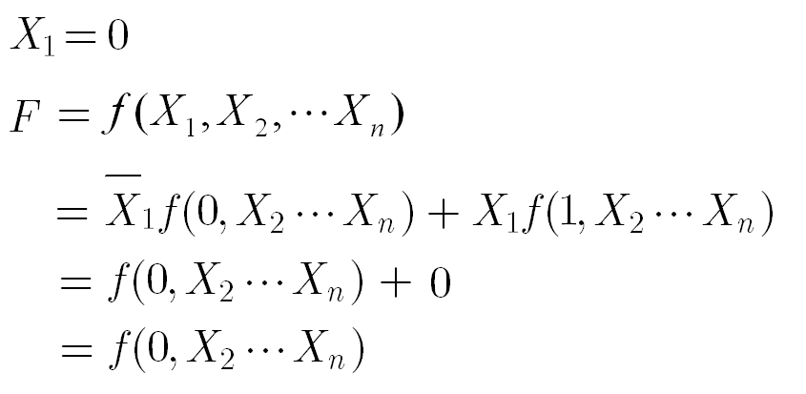

Slide 28
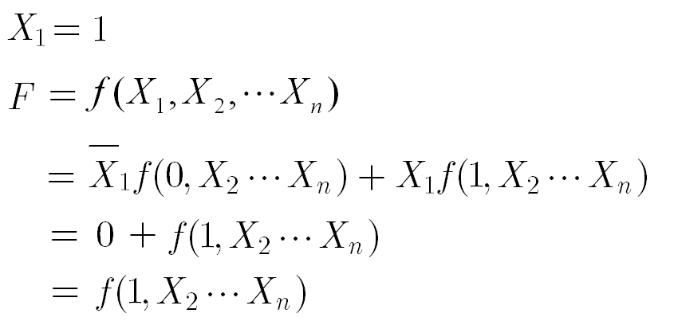

Slide 29
Example: Simplify logic function by expansion rule.
Solution: (separate variable A)
Notes:
Write A NOT dot. Replace A with 0 in the function.
Write A dot. Replace A with 1 in the function.
Variable A appears many times in function F.

Slide 30
2.2.3 Compound Functions
Logic gate
(hardware symbol)
NAND
A
F＝AB
A
F
B
B
NOR
A
A
F＝A＋B
F
B
B
Notes:
NAND gate: AND gate is followed by inverter
NOR gate: OR gate is followed by inverter

Slide 31
AND-OR-INVERTER
A
B
F=AB+CD
C
D
A
Logic gate
(hardware symbol)
F
B
C
D
Notes:
Two AND gates, followed by OR gate, then followed by inverter.

Slide 32
XOR
XNOR
exclusive or
exclusive nor
OR: inclusive or
Logic function
Logic gate (hardware symbol)
A
A
F
F
B
B
Notes:
Operator of XOR: plus inside a circle
Operator of XNOR: dot inside a circle
XOR equals …, XNOR equals …

Slide 33
How to understand XOR?
XOR：if A，B are unequal, then F=1.
How to understand XNOR?
XNOR：if A，B are equal, then F=1.
Notes:
How to understand XOR?
How to understand XNOR?

Slide 34
Truth Table
A B A B A B
0 0 0 1
0 1 1 0
1 0 1 0
1 1 0 1
If there are two inputs, the XOR result and the XNOR result are inverting.

Slide 35
Truth Table
A B C
A B C
A B C
0 0 0 0 0
0 0 1 1 1
0 1 0 1 1
0 1 1 0 0
1 0 0 1 1
1 0 1 0 0
1 1 0 0 0
1 1 1 1 1
If there are three inputs, XOR and XNOR are equal.
Notes:
If there are three inputs,

Slide 36
Rules of XOR and XNOR
(1)
1 0=0 1=1 0 1=1 0=0
0 0=0 1 1=1
1 1=0 0 0=1
0 A=A 1 A=A
(2)
1 A=A 0 A=A
A A=0 A A=1
A A=1 A A=0
Treat A as 1. Treat A as 0.
Notes:
If the two inputs are unequal, the xor result is 1.
If the two inputs are equal, the xnor result is 1.

Slide 37
(3) Commutative Law
A B=B A A B=B A
(4) Associative Law
A (B C)=(A B) C
A (B C)=(A B) C
Notes:
Commutative Law: we can exchange positions of A and B.
Associative Law: we can combine any two variables for calculation.

Slide 38
(5) Distributive Law
A(B C)=AB AC
Right=ABAC+ABAC=AB(A+C)+AC(A+B)
=ABC+ABC=A(B C)=Left
A+(B C)=(A+B) (A+C)
Right =(A+B) (A+C)+(A+B)(A+C)=ABC+A+BC
=A+BC+BC=A+(B C)= Left
Notes:
(1)Take AB as a whole. Take AC as a whole. Apply the De Morgan’s Laws. Remove parentheses. A and A NOT are offsetting.
Extract A. Write the XOR expression.
(2) Take parentheses as a whole. Apply the De Morgan’s Laws. Write A NOT once. Apply the distributive law of addition. A offsets A NOT. Write the XNOR expression.

Slide 39
(6) Interchange Law
A B C
0 0 0
0 1 1
If A B=C , then A C=B or B C=A
1 0 1
1 1 0
A B C
0 0 1
0 1 0
If A B=C, then A C=B or B C=A
1 0 0
1 1 1
Notes:
If exchange the input and output, the formula holds.
Prove it by truth table. Exchange input and output in the truth table.

Slide 40
Exercise
Prove the interchange law by truth table.
If A B=C , then A C=B or B C=A
If A B=C, then A C=B or B C=A

Slide 41
(7) Commonly Used Laws
1 (odd number of “1s”)
A₁ A₂ A_{n}=
0 (even number of “1s”)
1 (even number of “0s”)
A₁ A₂ A_{n}=
0 (odd number of “0s”)

Slide 42
1
1
0
0
=
?
1
1
1
=
?
0
0
0
=
0
odd number of “1s”
even number of “1s”
1
1
=
0
1
1
=
0
…...
…...
1
1
=
0
1
1
=
0
1
0
=
1
1 (odd number of “1s”)
A₁ A₂ A_{n}=
0 (even number of “1s”)

Slide 43
1
1
0
0
=
?
1
1
1
=
1
0
0
0
=
?
odd number of “0s”
even number of “0s”
0
0
=
1
0
0
=
1
…...
…...
0
0
=
1
0
0
=
1
0
1
=
0
1 (even number of “0s”)
A₁ A₂ A_{n}=
0 (odd number of “0s”)

Slide 44
Positive Logic and Negative Logic
If we use the high-voltage to represent the binary number “1”, and we use the low-voltage to represent the binary number “0”, the logic gate in the circuit is working in positive logic.
If we use the high-voltage to represent the binary number “0”, and we use the low-voltage to represent the binary number “1”, the logic gate in the circuit is working in negative logic.

Slide 45
The “AND” gate in positive logic is equal to the “OR” gate in negative logic.
AND Gate in Positive Logic
F=AB
OR Gate in Negative Logic
F=A+B
A
F
F
A
B
B
Because their voltage tables are the same！

Slide 46
Positive
Logic
Negative
Logic
Voltage Table
Input Output Truth Table Truth Table
V_{A} V_{B} V_{F} A B F A B F
0V 0V 0V 0 0 0 1 1 1
0V +3.6V 0V 0 1 0 1 0 1
+3.6V 0V 0V 1 0 0 0 1 1
+3.6V +3.6V +3.6V 1 1 1 0 0 0
F=AB
F=A+B

Slide 47
Dual functions of positive logic and negative logic
Positive Logic Negative Logic
Write the dual function of XOR. It is XNOR.

Slide 48
2.3.1 Standard Forms of Logic Functions
2.3 Function Transformation
1. Standard AND-OR Function
e.g.
2. Standard OR-AND Function
e.g.
Notes:
Standard AND-OR function: First do the multiplication. Second, do the addition.
Standard OR-AND function: First do the addition. Second, do the multiplication.

Slide 49
2.3.2 Canonical Forms of Logic Functions
1. Canonical AND-OR Function
Also, Sum of Products,
Sum of Minterms
e.g.
2. Canonical OR-AND Function
Also, Product of Sums,
Product of Maxterms
e.g.
Notes:
Canonical AND-OR Function: is composed of minterms
Canonical OR-AND Function: is composed of maxterms
These product terms are minterms.
These sum terms are maxterms.

Slide 50
3. Minterm
In each product term, each input variable occurs only once.
The input variable is in the original form (A) or the inverted form (A NOT).
The product term is named as Minterm.
If a function is composed of Minterms, it is named as the canonical AND-OR function.
010
Notes:
We use lowercase m to represent minterm.

Slide 51
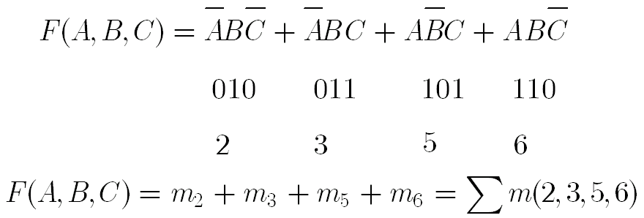
Treat A as 1.
Treat A as 0.

Slide 52
* Properties of Minterm
(1) With n inputs, there are 2^{n} minterms in total.
(2) With any input, only one minterm is “1”.
A,B,C=1,0,1,
(3)

Slide 53
(4)
(5)
The addition of two minterms offsets the inverting variables.
(6)
This minterm with “n” input variables has inverting variables with the other “n” minterms.

Slide 54
Exercise
Write the sum of minterms in decimal number.

Slide 55
4. Maxterm
In each sum term, each input variable occurs only once.
The input variable is in the original form (A) or the inverted form (A NOT).
The sum term is named as Maxterm.
If a function is composed of Maxterms, it is named as the canonical OR-AND function.
000
Notes:
We use uppercase M to represent maxterm.

Slide 56
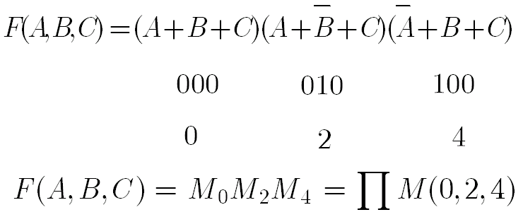
Treat A as 0.
Treat A as 1.

Slide 57
Exercise
Write the product of maxterms in decimal number.

Slide 58
* Properties of Maxterm
(1) With any input, only one maxterm is“0”.
A,B,C＝1,0,1，
(2)

Slide 59
(3)
(4)
The product of two maxterms offsets the inverting variables.
(5)

Slide 60
Numbered
Minterm
Numbered
Maxterm
A B C
Minterm
Maxterm
0 0 0 m₀ M₀
0 0 1 m₁ M₁
0 1 0 m₂ M₂
0 1 1 m₃ M₃
1 0 0 m₄ M₄
1 0 1 m₅ M₅
1 1 0 m₆ M₆
1 1 1 m₇ M₇

Slide 61
2.3.3 Transformation of Logic Functions
Convert the function to sum of Minterms or product of Maxterms.
1. Write the sum of Minterms of a function.
Step 1: Write the standard AND-OR function
Step 2: Apply the following formula to recover the missing variable in product terms.

Slide 62
Example of Minterms
All the Minterms of function F(A,B) with two inputs
Minterms
Binary numbers for Minterms
Numbered Minterms

Slide 63
Example of Minterms
All the Minterms of function F(A,B,C) with three inputs
Minterms
Binary numbers for Minterms
Numbered Minterms

Slide 64
Example: Write the sum of Minterms of a function.
Apply the following formula to recover the missing variable in product terms.

Slide 65
Exercise
Write the sum of minterms of the function.

Slide 66
Example: Convert to sum of Minterms.
Solution:
(1) Get the standard AND-OR function.
(2) Recover missing variables.

Slide 67
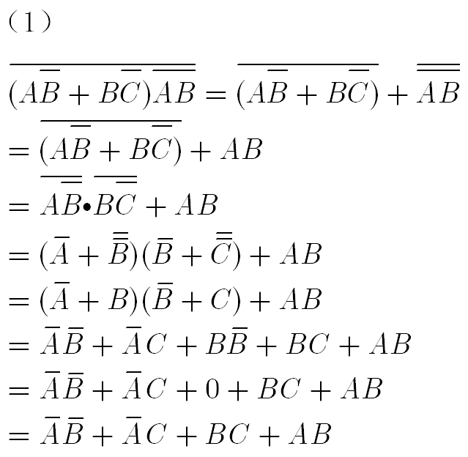
Details on function simplification

Slide 68
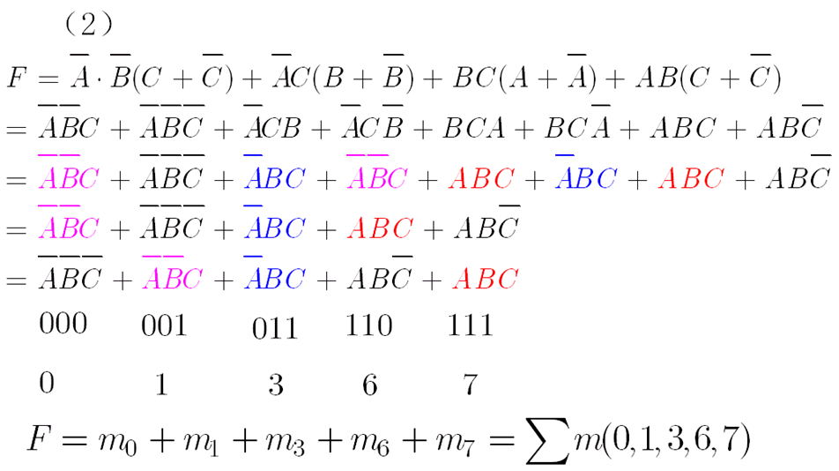
Details on recovering missing variables

Slide 69
Exercise
Write the sum of minterms of the function.

Slide 70
2. Write the product of Maxterms of a function.
Step 1: Write the standard OR-AND function
Step 2: Apply the following formula to recover the missing variable in sum terms.

Slide 71
Example of Maxterms
All the Maxterms of function F(A, B) with two inputs
Maxterms
Binary numbers for Maxterms
Numbered Maxterms

Slide 72
Example of Maxterms
All the Maxterms of function F(A, B, C) with three inputs
Maxterms
Binary numbers for Maxterms
Numbered Maxterms

Slide 73
Example: Write the product of Maxterms of a function.
Apply the following formula to recover the missing variable in sum terms.

Slide 74
Exercise
Write the product of maxterms of the function.

Slide 75
Example: Convert to product of Maxterms.
Solution:
(1) Get the standard OR-AND function.
A+BC=(A+B)·(A+C)
distributive law of addition

Slide 76
A+BC=(A+B)·(A+C)
distributive law of addition
1

Slide 77
(2) Recover missing variables.
Apply the following formula
111
110
011

Slide 78
Exercise
Write the product of maxterms of the function.

Slide 79
2. Function Transformation by Truth Table
Example: Convert to sum of Minterms by truth table.
A B C F
0 0 0 0
0 0 1 0
0 1 0 1
0 1 1 0
1 0 0 1
1 0 1 1
1 1 0 1
1 1 1 0

Slide 80
Write sum of Minterms from Truth Table.
A B C F
0 0 0 0
0 0 1 0
0 1 0 1
m₂
0 1 1 0
1 0 0 1
m₄
1 0 1 1
m₅
1 1 0 1
m₆
1 1 1 0

Slide 81
Exercise
Write the sum of minterms by truth table.

Slide 82
Example: Convert the following function to product of maxterms by truth table.
A B C F
0 0 0 0
0 0 1 0
0 1 0 1
0 1 1 0
1 0 0 1
1 0 1 1
1 1 0 1
1 1 1 0

Slide 83
Write product of Maxterms from Truth Table.
A B C F
0 0 0 0
M₀
0 0 1 0
M₁
0 1 0 1
0 1 1 0
M₃
1 0 0 1
1 0 1 1
1 1 0 1
1 1 1 0
M₇

Slide 84
Exercise
Write the product of maxterms by truth table.

Slide 85
2.4.1 Simplification by Formulas
2.4 Function Simplification
What is the simplest AND-OR function?
(1) The number of product terms is the fewest.
(2) The number of variables in each term is the fewest.

Slide 86
1. Simplification of AND-OR Functions
(1) Apply
Example 1：
(2) Apply
Example 2：
(3) Apply
Example 3：

Slide 87
Exercise
Simplify the functions.

Slide 88
(4) Apply the formula
Example 4：
Apply the formula
Notes:
We use auxiliary term to help simplification.

Slide 89
Exercise
Simplify the function.

Slide 90
Example 5：
Example 6：

Slide 91
Exercise
Simplify the functions.

Slide 92
Example 7：
Notes:
In order to get the dual function, exchange dot and plus.

Slide 93
Exercise
Simplify the function.

Slide 94
2. Simplification of OR-AND Functions
Example 1：
Get the dual form
Get the dual form again
Notes:
In order to get the dual function, exchange dot and plus.

Slide 95
Example 2：
Get the dual form
Get the dual form again

Slide 96
Exercise
Simplify the function.

Slide 97
2.4.2 Simplification by K-Map
K-map is based on the Gray Code in Chapter One.
We can use K-map to simplify the logic functions.
If we draw K-circles on “1” blocks, we get the simplest AND-OR function.
If we draw K-circles on “0” blocks, we get the simplest OR-AND function.

Slide 98
Rules for K-circles on “1” blocks
(1) We draw a K-circle on 2^{n} (n=0,1,2,…) adjacent “1” blocks.
(2) Each “1” block can be circled many times.
(3) Each K-circle must contain at least one independent “1” block.
(4) 2^{n} adjacent “1” blocks must form a rectangle or a square.

Slide 99
(5) We draw as bigger K-circles as possible.
(6) The fewer K-circles are the better.
(7) We can draw a K-circle on the both ends of the K-map.
(8) For a K-circle, we write “0” as inverted variable (i.e., A NOT) and write “1” as original variable (i.e., A). We get the simplified product term.
(9) We can obtain the simplest AND-OR function.

Slide 100
Simplify Logic Function by K-Map Example 1

Slide 101
K-Map for Function with 2 Input Variables

Slide 102
F
B
0
1
A
0
m₀
m₁
1
m₂
m₃
A is the higher bit Variable. Put A in the vertical direction.
B is the lower bit Variable. Put B in the horizontal direction.
The gray code for variable A is 0 and 1.
The gray code for variable B is 0 and 1.

Slide 103
F
B
0
1
A
0
m₀
m₁
1
m₂
m₃
Function F has 2 input variables.
There are 4 Minterms for function F
00(m₀), 01(m₁), 10(m₂), 11(m₃).

Slide 104
F
BC
00
01
11
10
A
0
m₀
m₁
m₃
m₂
1
m₄
m₅
m₇
m₆
A is the highest bit variable. Put A in the vertical direction.
BC are the lower bit variables. Put BC in the horizontal direction.
The gray code for variable A is 0 and 1.
The gray code for variables BC is 00, 01, 11, 10.

Slide 105
F
BC
00
01
11
10
A
0
m₀
m₁
m₃
m₂
1
m₄
m₅
m₇
m₆
Function F has 3 input variables.
There are 8 Minterms for function F
000(m₀), …, 111(m₇).

Slide 106
Write the simplest AND-OR function by K-Map.
Find all the Minterms.
Notes:
Add C plus C NOT to recover variable C.
Add B plus B NOT to recover variable B.
Remove parentheses. Write the redundant terms once.
Then, we get all the minterms. Write the numbered minterms.

Slide 107
Put the Minterms in K-map.
F
BC
00
01
11
10
A
0
1
1
1
1
1
F=AC+BC+AB
Notes:
Put the minterms in the K-map.
011 for m3.
Draw K-circles. For the circle on the left, we write A C.
Finally, we get the simplified function.

Slide 108
Exercise
Simplify the function by K-map.

Slide 109
Simplify Logic Function by K-Map Example 2

Slide 110
F
CD
00
01
11
10
AB
00
m₀
m₁
m₃
m₂
01
m₄
m₅
m₇
m₆
11
m₁₂
m₁₃
m₁₅
m₁₄
10
m₈
m₉
m₁₁
m₁₀
K-map for the function F

Slide 111
Function F has 4 input variables.
There are 16 Minterms for function F
0000(m₀), …, 1111(m₁₅).
The gray code for variables AB is 00, 01, 11, 10.
The gray code for variables CD is 00, 01, 11, 10.
AB are higher bit variables. Put AB in the vertical direction.
CD are lower bit variables. Put CD in the horizontal direction.

Slide 112
Recover the product terms in the K-map.
e.g.
0100
1100
1010
0111
0011
1100
1101
1011
0101
0111
F
CD
1111
1011
AB
00
01
11
10
1101
1111
00
1
01
1
1
1
11
1
1
1
10
1
1
Notes:
B C NOT D NOT, means if B is 1, C is 0, D is 0, A is 0 or 1, then F is 1.
Mark the block 0100 as 1.
Similarly, we can recover all the product terms.
Draw K-circle. For the left circle, we B C NOT.
Finally, we get the simplified function.

Slide 113
Exercise
Simplify the function by K-map.

Slide 114
Rules for K-circle on “0” blocks
(1) We draw a K-circle on 2^{n} (n=0,1,2,…) adjacent “0” blocks.
(2) Each “0” block can be circled many times.
(3) Each K-circle must contain at least one independent “0” block.
(4) 2^{n} adjacent “0” blocks must form a rectangle or a square.

Slide 115
(5) We draw as bigger K-circles as possible.
(6) The fewer K-circles are the better.
(7) We can draw a K-circle on the both ends of the K-map.
(8) For a K-circle, we write “0” as original variable (i.e., A) and write “1” as inverted variable (i.e., A NOT). We get the simplified sum term.
(9) We can obtain the simplest OR-AND function.

Slide 116
Simplify Logic Function by K-Map Example 3

Slide 117
F
CD
00
01
11
10
AB
00
M₀
M₁
M₃
M₂
01
M₄
M₅
M₇
M₆
11
M₁₂
M₁₃
M₁₅
M₁₄
10
M₈
M₉
M₁₁
M₁₀
K-map for the function F

Slide 118
Function F has 4 input variables.
There are 16 Maxterms for function F
0000(M₀), …, 1111(M₁₅).
The gray code for variables AB is 00, 01, 11, 10.
The gray code for variables CD is 00, 01, 11, 10.
AB are higher bit variables. Put AB in the vertical direction.
CD are lower bit variables. Put CD in the horizontal direction.

Slide 119
Write the simplest OR-AND function by K-Map.
Example: F(A,B,C,D)=∏M(3,7,11,12,13,14,15)
Can you write all the minterms for the function?
F(A,B,C,D)=∑m(0,1,2,4,5,6,8,9,10)
Numbers from 0 to 15 which are not in maxterms belongs to minterms.
Notes:
The function is composed of maxterms.
Can you write all the minterms for the function?
Numbers from 0 to 15 which are not in maxterms belongs to minterms.

Slide 120
Mark the blocks as 0 according to maxterms.
F(A,B,C,D)=∏M(3,7,11,12,13,14,15)
F
CD
AB
00
01
11
10
00
0
01
0
11
0
0
0
0
10
0
Notes:
How to write the K-map?
Method one: mark the blocks as 1 according to minterms. Method two: mark the blocks as 0 according to maxterms.
Draw circles on‘0’blocks. Write the sum terms.
For the horizontal circle, we write A NOT plus B NOT. For the vertical circle, we write C NOT plus D NOT.
Use AND to connect the sum terms. Finally, we get the simplified OR-AND function.

Slide 121

Draw K-circles on‘0’blocks.
Write the sum terms.
Use AND to connect the sum terms.
F
CD
AB
00
01
11
10
00
0
01
0
11
0
0
0
0
10
0
Notes:
How to write the K-map?
Method one: mark the blocks as 1 according to minterms. Method two: mark the blocks as 0 according to maxterms.
Draw circles on‘0’blocks. Write the sum terms.
For the horizontal circle, we write A NOT plus B NOT. For the vertical circle, we write C NOT plus D NOT.
Use AND to connect the sum terms. Finally, we get the simplified OR-AND function.

Slide 122
Exercise
Simplify the function by K-map.
F(A,B,C,D)=∏M(3,7,11,12,13,14,15)

Slide 123
Summary
In the K-map, drawing circles on “1” blocks will generate the simplest AND-OR function.
In the K-map, drawing circles on “0” blocks will generate the simplest OR-AND function.

Slide 124
More Examples on K-map The K-map is given. Draw the K-Circles.

Slide 125
Draw K-circles on “1” blocks to get the simplest AND-OR function.

Slide 126
F₁
F₂
B
B
0
1
0
1
A
A
0
0
1
1
1
1
1
1
1

Slide 127
The simplest function may not be unique.

Slide 128
Solution 1:
F₃
BC
00
01
11
10
A
0
1
1
1
1
1
1
1

Slide 129
Solution 2:
F₃
BC
00
01
11
10
A
0
1
1
1
1
1
1
1

Slide 130
F₄
BC
00
01
11
10
A
0
1
1
1
1
1
1

Slide 131
F₅
BC
00
01
11
10
A
0
1
1
1
1
1

Slide 132
F₆
BC
00
01
11
10
A
0
1
1
1
1
1
1
1

Slide 133
F₇
BC
00
01
11
10
A
0
1
1
1
1
1
1
1
1
1
F₇=1

Slide 134
F₈
CD
00
01
11
10
AB
00
1
01
1
1
1
11
1
1
1
10
1

Slide 135
F₉
CD
00
01
11
10
AB
00
1
01
1
1
1
11
1
1
1
10
1

Slide 136
F₁₀
CD
00
01
11
10
AB
00
1
1
01
1
1
11
1
1
10
1
1

Slide 137
F₁₁
CD
00
01
11
10
AB
00
1
01
1
1
11
1
1
1
10
1
1
1
1

Slide 138
F₁₂
CD
00
01
11
10
AB
00
1
1
01
1
1
11
1
1
10
1
1

Slide 139
Draw K-circles on “0” blocks to get the simplest OR-AND function.

Slide 140
F₁₃
CD
00
01
11
10
AB
00
0
0
0
01
0
11
0
10
0
0
0

Slide 141
F₁₄
CD
00
01
11
10
AB
00
0
0
01
0
0
11
0
0
10
0
0

Slide 142
F₁₅
CD
00
01
11
10
AB
00
0
0
0
01
0
0
11
0
10

